Slide 1
HCC Exome Sequencing Data Analysis

Slide 2
Overview
Gene | MutSig | Fisher | LASSO+Logistic | Tree
TP53 | #INF | 0.304314 | 534 | 397
BCL3 | 6.578463 | 0.379915 | 22 | 324
FGFR3 | 4.114166 | 0.907361 | 12 | 97
ROS1 | 3.79366 | 0.715099 | 223 | 384
CDH20 | 3.402687 | 0.126267 | 136 | 197
CRTC1 | 1.353728 | 0.408134 | 758 | 416
MAPK14 | 0.985175 | 0.125272 | 921 | 521
PAX3 | 0.846119 | 0.48336 | 388 | 123
DAXX | 0.453568 | 0.448639 | 87 | 166
NCOA4 | 0.450982 | 0.306448 | 38 | 69
TCF3 | 0.450982 | 0.344961 | 732 | 52
RECQL4 | 0.373311 | 0.479618 | 131 | 106
PLCG1 | 0.137132 | 1 | 319 | 41
SETD2 | 0.04839 | 0.082846 | 588 | 464
STK36 | 0.04839 | 0.536567 | 148 | 81
101
Hypermutated
7
94
PR:2
SD:3
PD:2
Unknown
8
86
PR+CR:11
SD:47
PD:28
// Targeted exome sequencing
440 designed genes of advanced
HCC patients
(recurrent in 2 years)
with Sorafenib treatment.

Slide 3
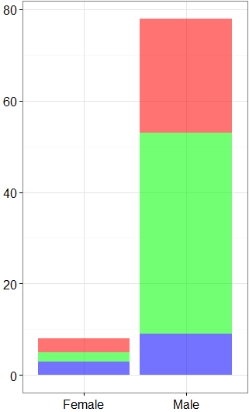
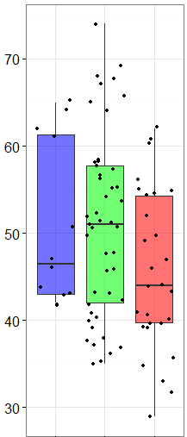
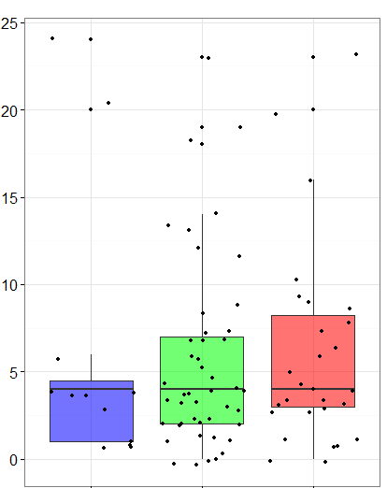
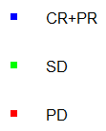
Clinical Information
Sex: Fisher：0.08
Age: Fisher：0.2551
Recurrent time: Fisher：0.562

Slide 4
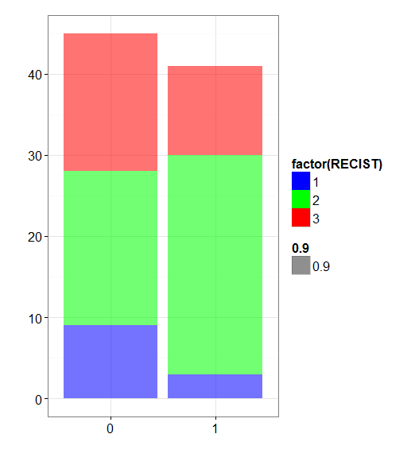
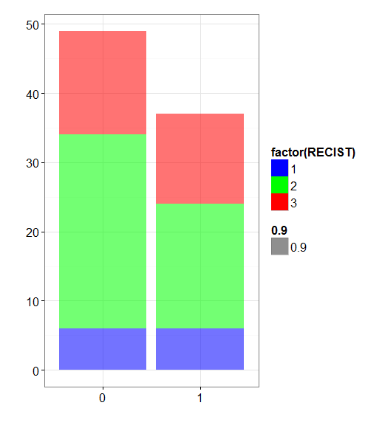
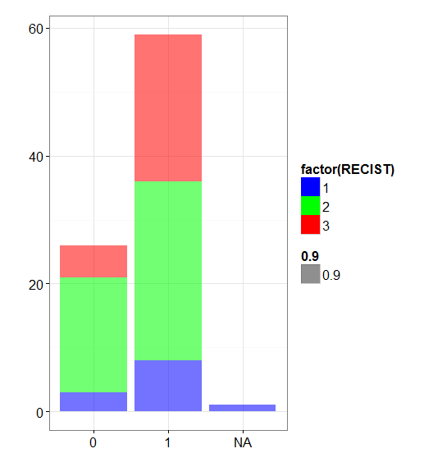
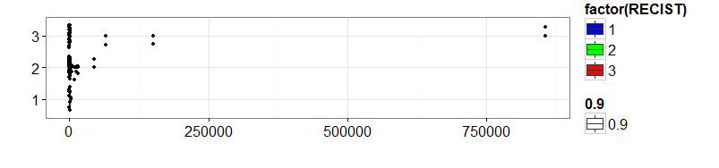
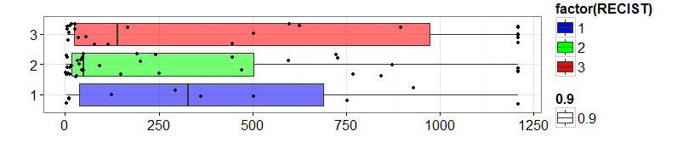
HBVDNA: 0.07
Cirrhosis:0.72
Microvascular_invasion : 0.16
Outlier
CR+PR | 2
SD | 10
PD | 4
AFP: 0.4349

Slide 5
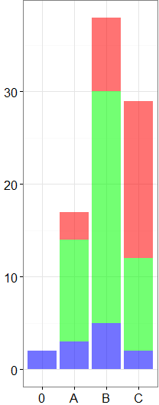
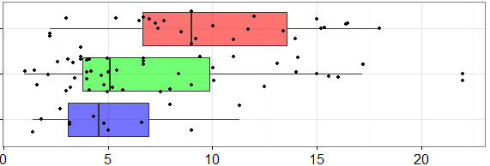
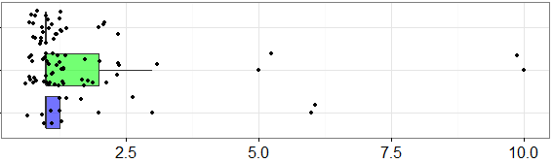
Tumor size(Avg) : 0.004
BCLC Stage: 0.00141
BCLC_Stage | CR+PR | SD | PD
0 | 2 | 0 | 0
A | 3 | 11 | 3
B | 5 | 25 | 8
C | 2 | 10 | 17
Tumor Num: 0.19

Slide 6
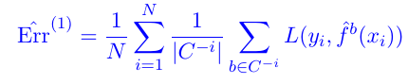
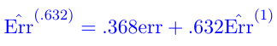
Leave-one-out Bootstrap Strategy （.632 estimator）:
For every sample:
1. leave it out
2. bootstrap balanced samples(100) from each class of remaining samples(30*3) =>8600 bootstrap samples (leave-one-out cv.glmenet to choose the best lambda)
3. compute mean error for this sample

Slide 7
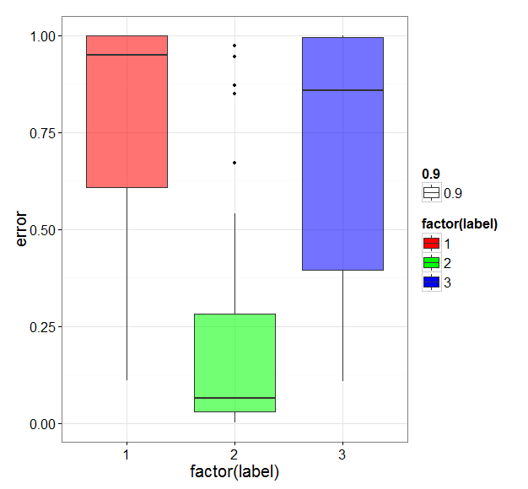
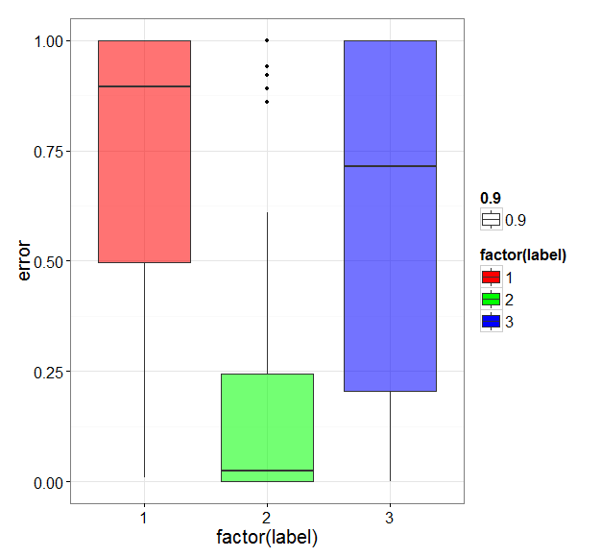
Sex | Age | RT | AFP | HBV | size | num | Cirrhosis | MI | BCLC
90.6% | 91.1% | 49.2% | 75% | 70% | 90.9% | 92.7% | 44.3% | 44.9% | 99.5%
//Only use Sex,Age,size,num,BCLC
// mean error: 46.9%

Slide 8
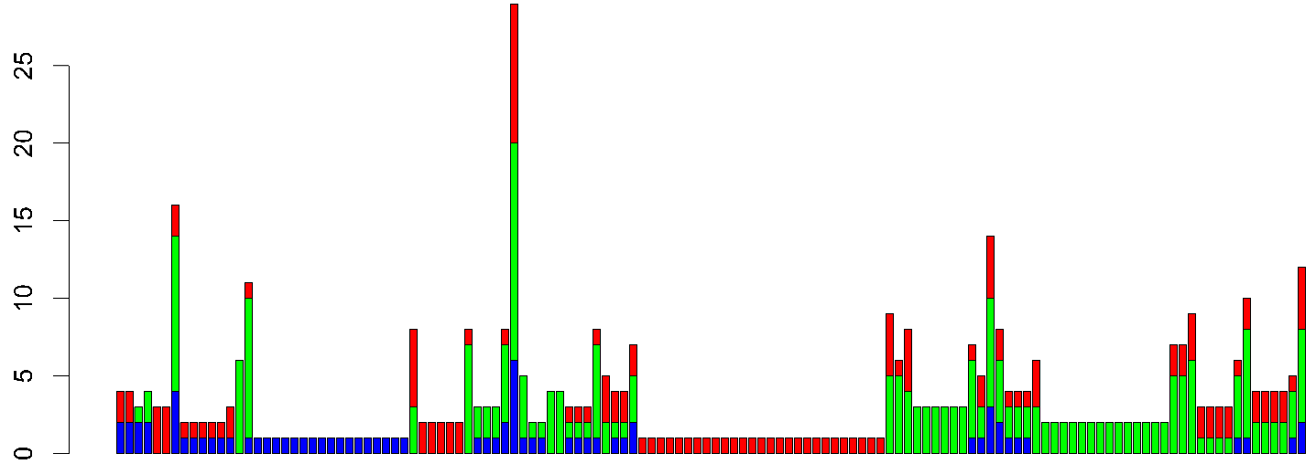
Feature Selection
Preserve only significantly mutated genes
MutSigCV: p.values < 0.01 => remain 68 genes
No. of patients
Only one mutation happened
// Fisher’s exact test for each gene

Slide 9
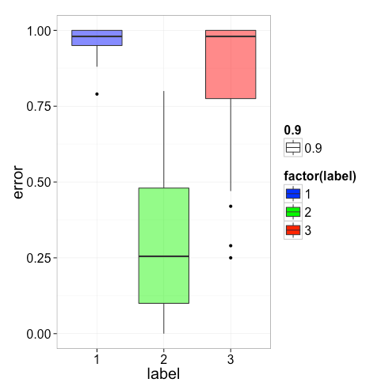
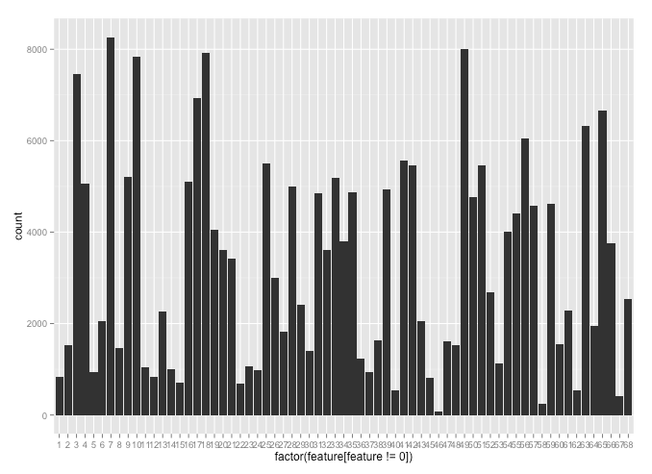
Leave-one-out Bootstrap Strategy of LASSO:
APC
CSMD3
POUF5F1
BCL3
YAP1
TP53
CRTC1

Slide 10
Gene | MutSig | Order
TP53 | #INF | 7
BCL3 | 6.578463 | 4
FGFR3 | 4.114166 | 11
ROS1 | 3.79366 | 27
CDH20 | 3.402687 | 59
CRTC1 | 1.353728 | 6
MAPK14 | 0.985175 | 60
PAX3 | 0.846119 | 12
DAXX | 0.453568 | 35
NCOA4 | 0.450982 | 57
TCF3 | 0.450982 | 65
RECQL4 | 0.373311 | 13
PLCG1 | 0.137132 | 47
SETD2 | 0.04839 | 9
STK36 | 0.04839 | 46
Computing p-values: (permutation)
Do the following 10000
1. Permutation label (ratio=12:46:28)
2. Do the above bootstrap procedure
Computing p.values

Slide 11
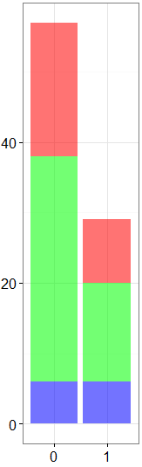
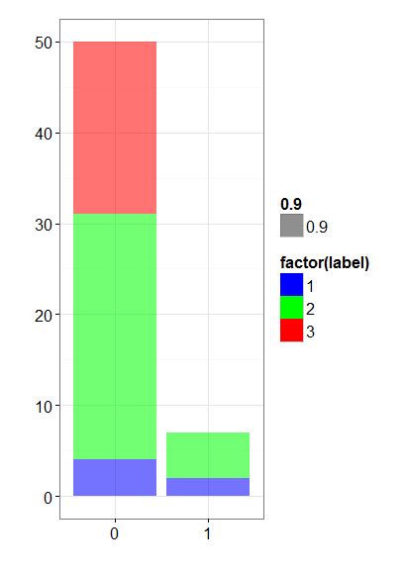
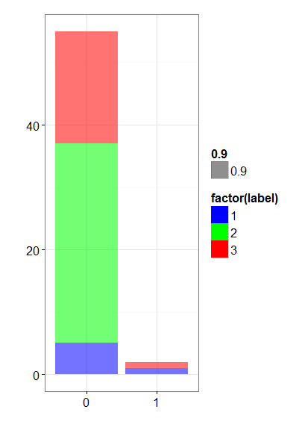
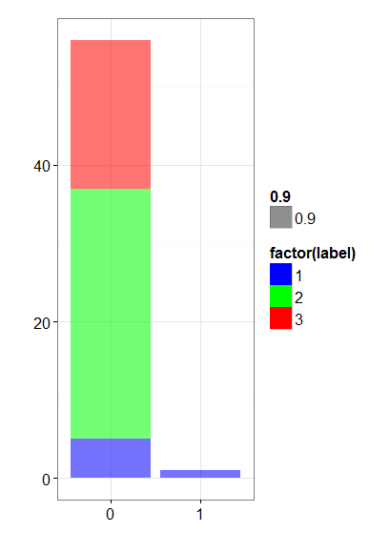
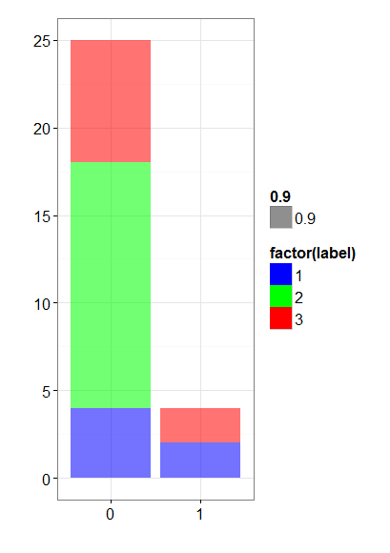
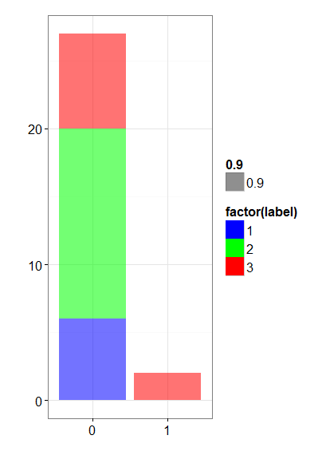
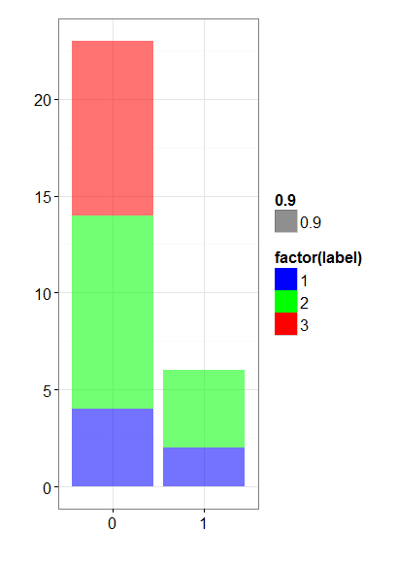
TP53 Gene:
TP53 | CR+PR | SD | PD
0 | 6 | 32 | 19
1 | 6 | 14 | 9
Fisher’s exact test: 0.304314
THBS1:0.05
EP300:0.08
FOXL2:0.1
SYNE1:0.07
ALK:0.13
SETD2:0.17

Slide 12
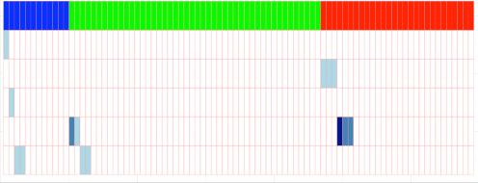
Test Genes Combinations:
POU5F1 | CRTC1
POU5F1 | BCL2L2
CRTC1 | BCL2L2
ALK | ARRB1
POU5F1 | ARRB1
Gene1 | Gene2
ALK | POU5F1
ALK | CRTC1
ALK | BCL2L2
CRTC1 | ARRB1
BCL2L2 | ARRB1
ARRB1
ALK
BCL2L2
CRTC1
POU5F1

Slide 13
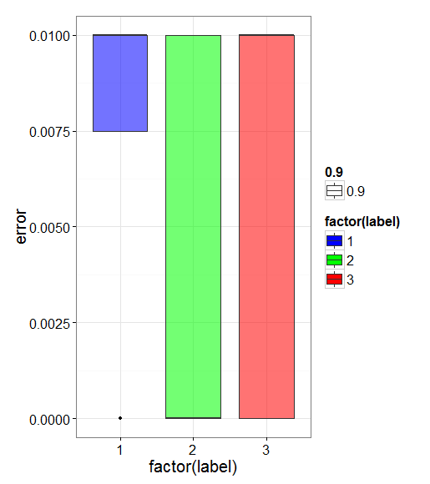
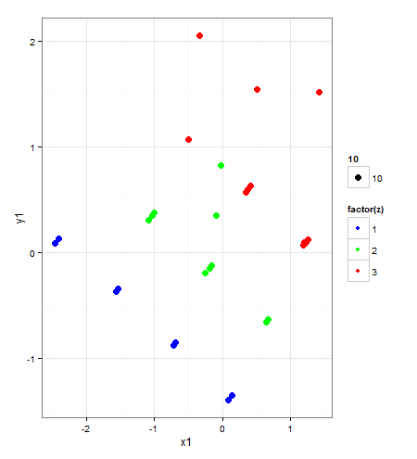
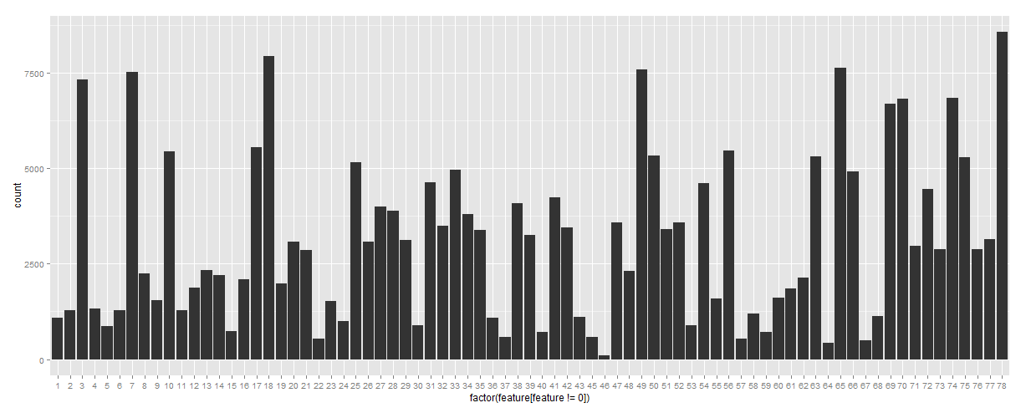
Test Combinations of Gene and Clinical Information:
//PCs of 5 features
BCLC_stage
ALK
CRTC1
POU5F1
TP53

Slide 14
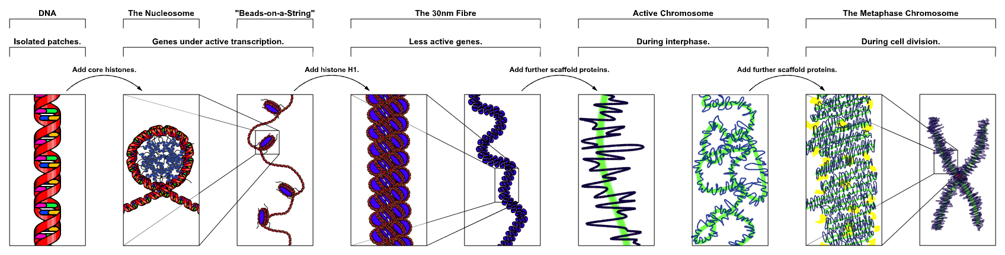
Tumor “Abstract” Feature
Subtypes
Drug Response
Clinical Infomation
Molecular Data
Environment Factor
Gene
Neucleotide Site
Notes:
许多问题值得讨论：
1.组学数据：不同组学数据各自的特点及处理方法
2.整合多组学数据

Slide 15
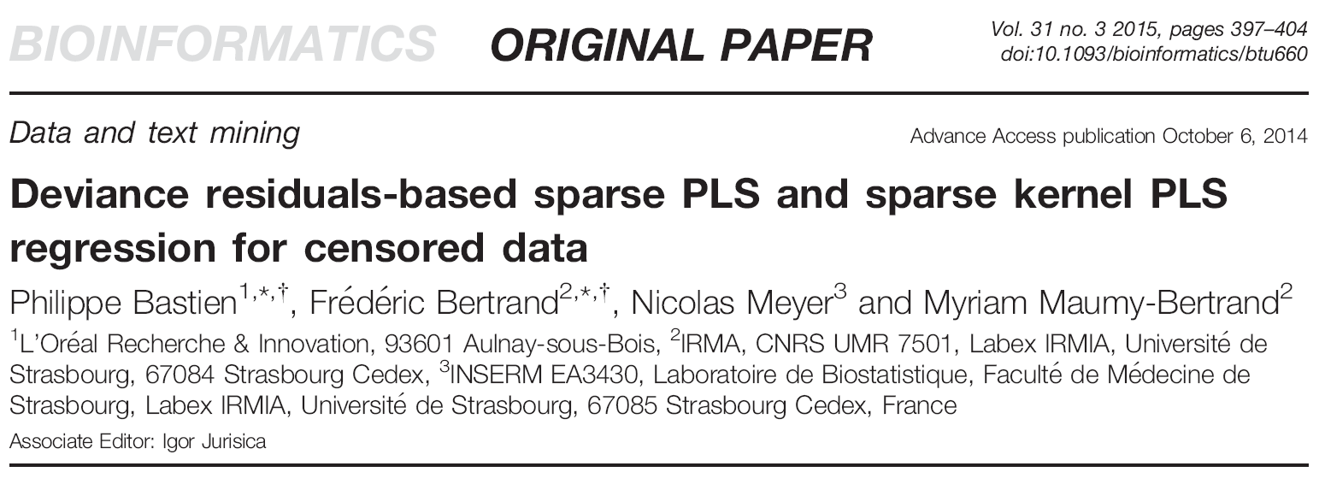
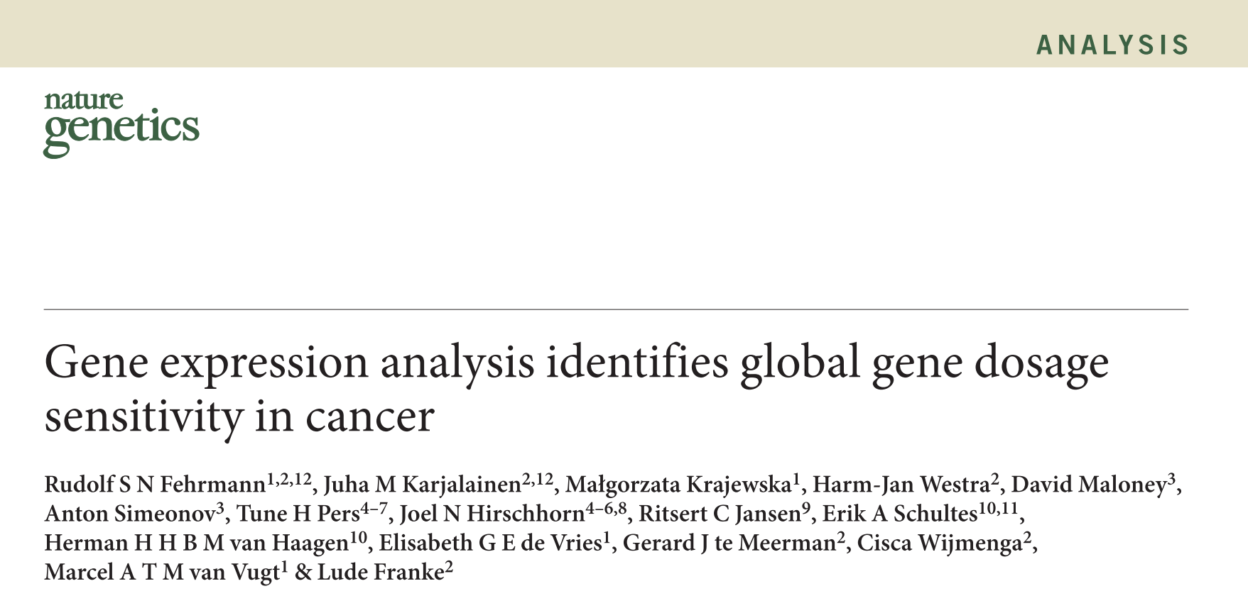
Notes:
许多问题值得讨论：
1.组学数据：不同组学数据各自的特点及处理方法
2.整合多组学数据

Slide 16
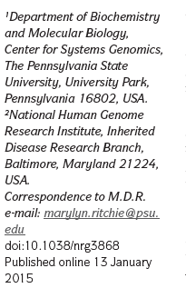
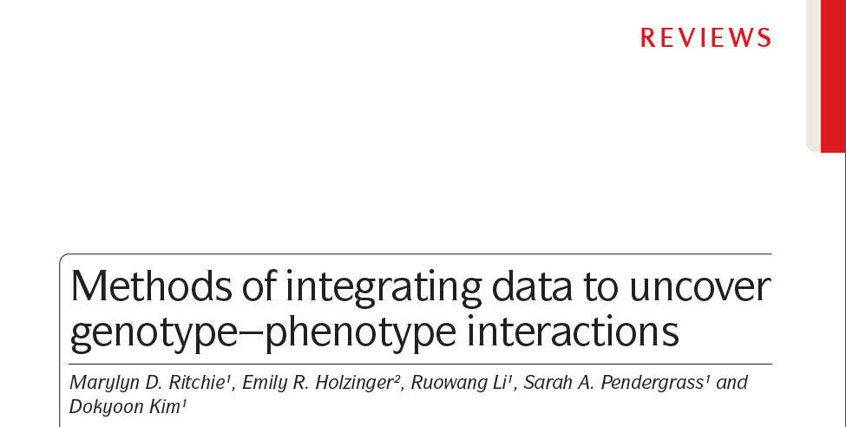
Paper Introduction

Slide 17
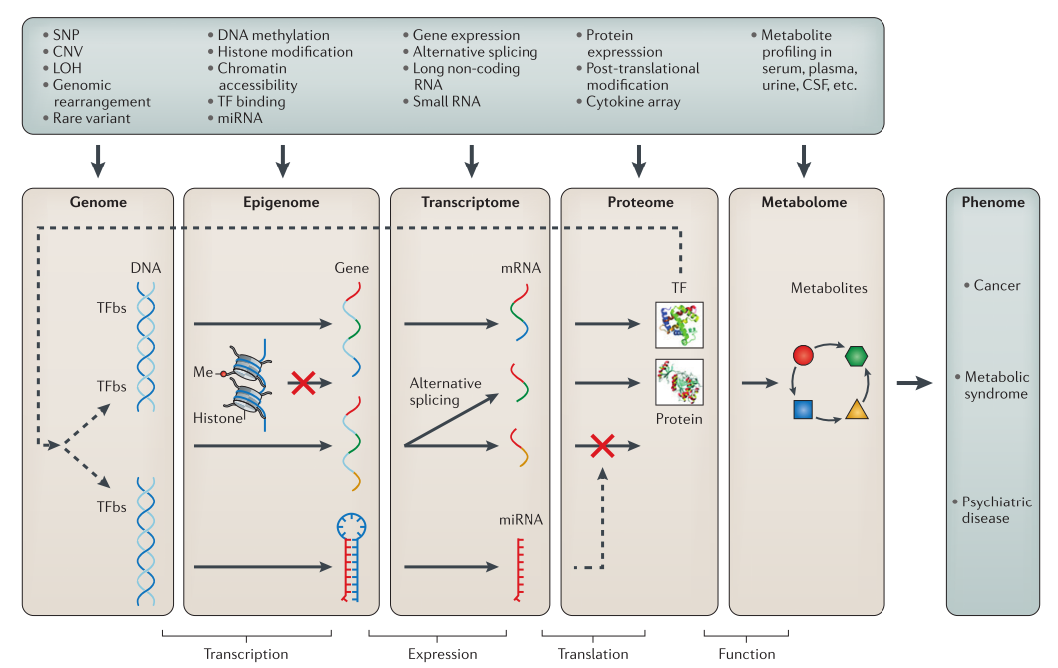

Slide 18
Why system genomics approaches?
Complete biological model for complex traits
Much of the genetic aetiology and biological network of complex traits remains unexplained.
Compensate for missing or unreliable information in any single data type
Multiple sources of evidence pointing to the same gene or pathway are less likely to lead false positives.
......

Slide 19
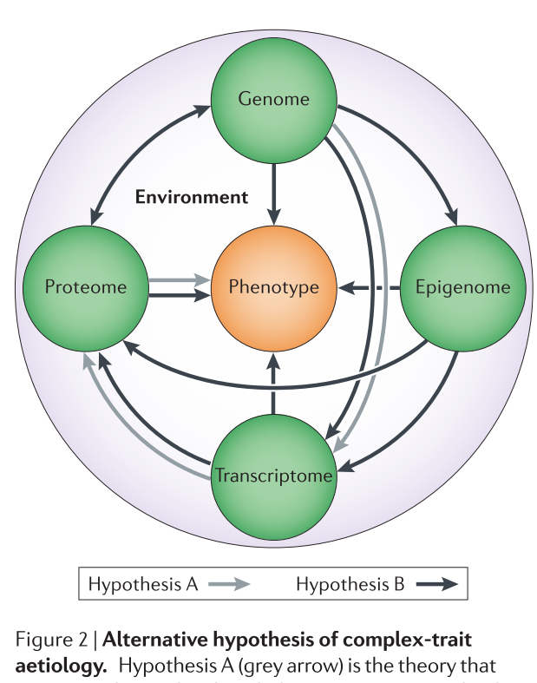
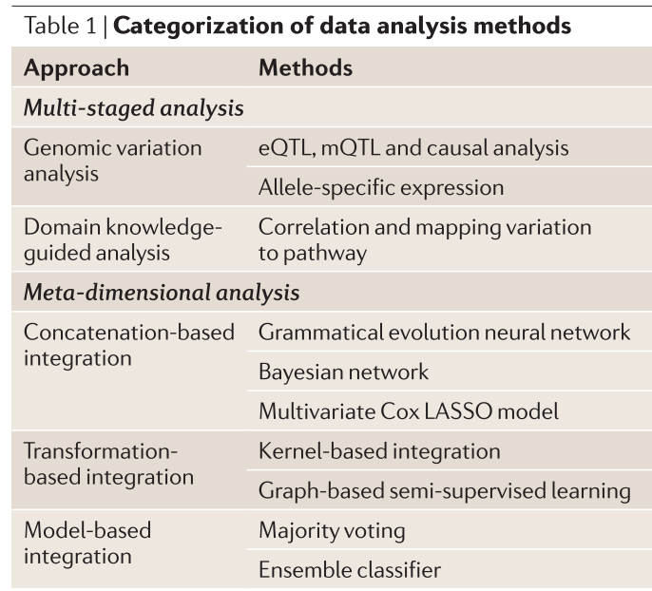

Slide 20
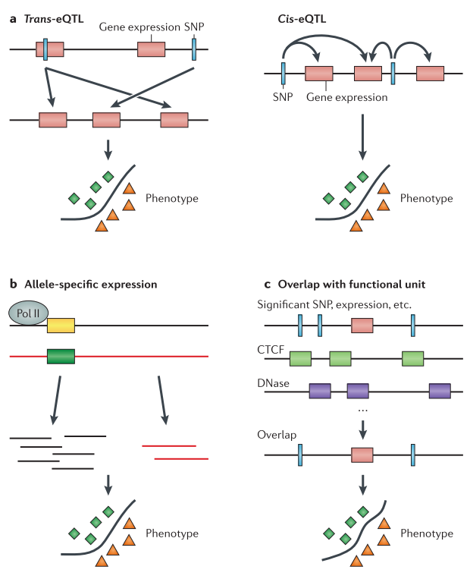

Slide 21
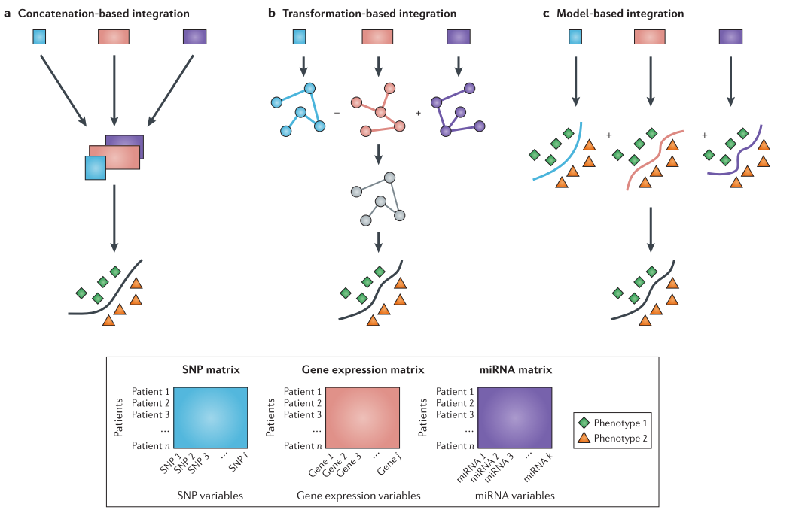

Slide 22
Key Points
An analysis that assesses variation of only a single omic data can miss complex models that require variation across multiple levels of biological regulation.
Approaches need to be selected according to different types of scientific quations.
Key genomic factors, and importantly their interactions
Assembling all of these data types into a more complete biological story is immensely challenging.
Evaluating each data type carefully before integration is important to avoid downstream problems with the analysis.

Slide 23
3. Density-based Cluster Analysis

Slide 24
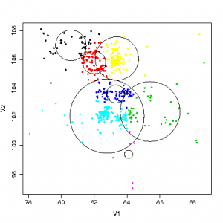
General Overview of Cluster Analysis
Given a set of data points, partition them into a set of clusters:
as similar as possible within the same cluster
dissimilar to points in other cluster
similarity measure
(Minkowski, Jaccard, cosine, cor, ... )
partition criteria
number of clusters, hierarchical, exclusive,
quality...
scalability
large-scale, high dimension,subspace,...
noisy data/outliers

Slide 25
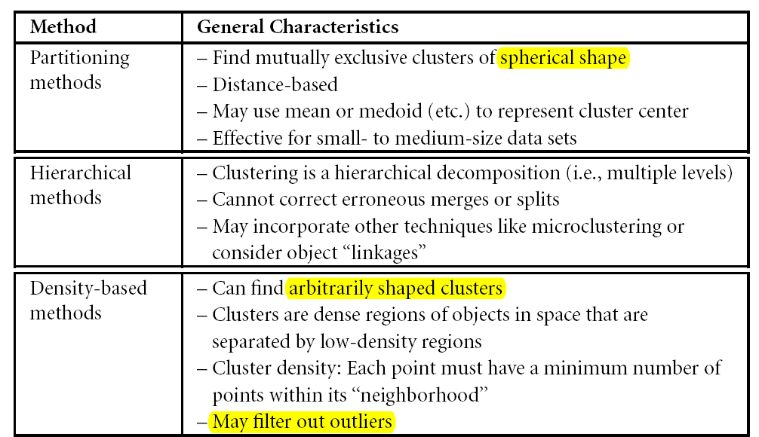
Basic Clustering Methods
// probabilistic model-based (Fuzzy,...),
high-dimension(subspace,spectral,DR,NMF,biclustering,...),
Network cluster, semi-supervised...

Slide 26
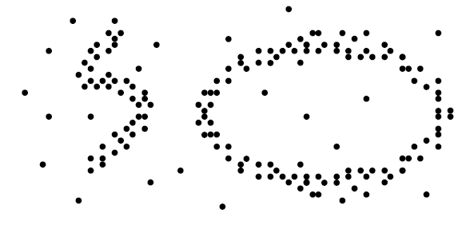
Density-based Clustering
Model clusters as dense regions in the data space, which is separated by sparse regions.
How do we define and find dense regions?

Slide 27
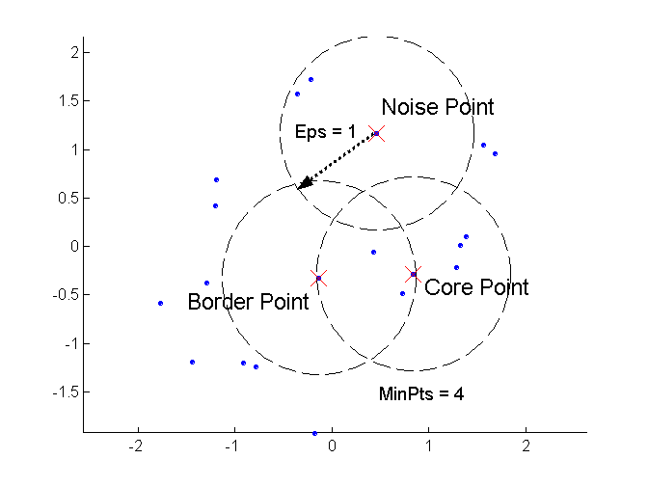

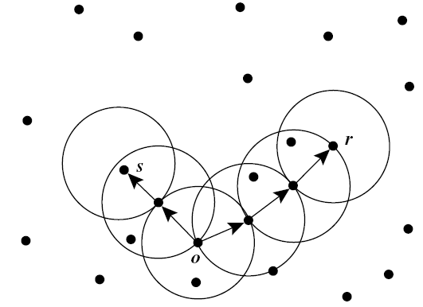
1. DBSCAN
Density-Based Spatial Clustering of Applications with Noise
Find core objects and cluser by density-connectedness
Notes:
http://en.wikipedia.org/wiki/DBSCAN advantage/disadvantage/parameter estimation

Slide 28
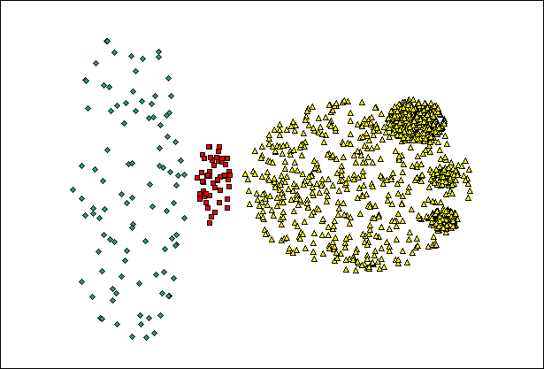
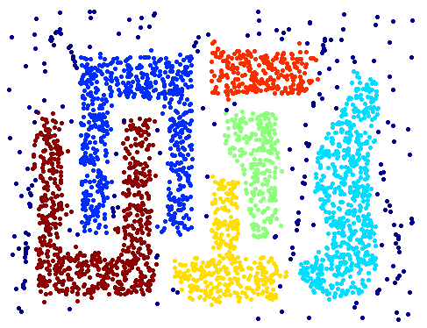
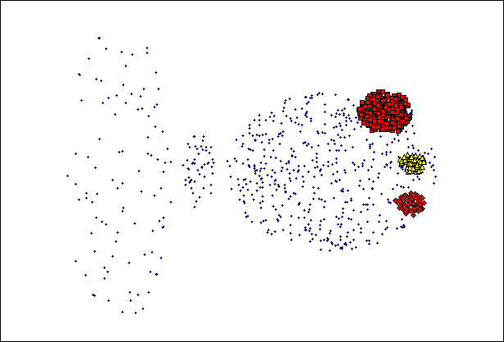
//varying densities
//high-dimension
Notes:
Sometimes work well! But can work very bad ( 全局统一阈值 )!

Slide 29
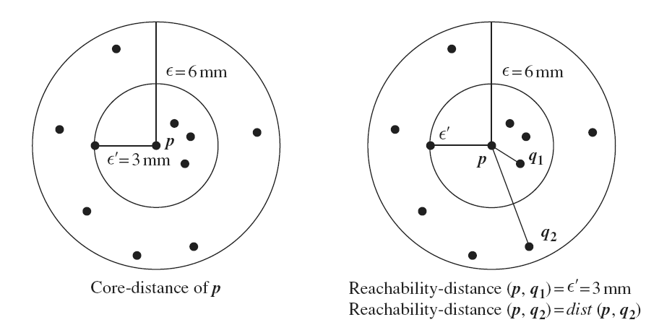
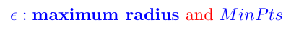


2. OPTICS
Ordering Points to Identify Clustering Structures
Notes:
http://en.wikipedia.org/wiki/OPTICS_algorithm extensions

Slide 30


Slide 31



3. DENCLUE
DENsity-based CLUstEring
Clustering based on density distribution function
Up to now, our methods are looking for dense areas
DENCLUE uses density directly
//kernel density estimation
// By efficient data structure, DENCLUE is much faster than others.
Notes:
map out all space!（估计整个空间或者包含数据点的超立方体内的所有密度）

Slide 32

4. Paper Introduction
* Science, 2014

Slide 33



local density:
distance from other densier points:
Notes:
数据集较小时，需要使用kernel估计

Slide 34



Slide 35




5. t-SNE
t-distributed stochastic neighbor embedding (nonlinearly dimensionality reduction )(Laurens van der Maaten and Geoffrey Hinton,2008)

Slide 36








Data Points:
Conserve the structure
Map Points:
Similarity Matrix:
KL divergence：
Why t-distribution:

Slide 37

Paper Introduction 1
Genetic heterogeneity between and within individual tumors
Mixed-membership: each sample as a mixture of genomic subtypes

Slide 38




Laplace distri:
sparsity
Dirichlet distribution
cluster centroids
mixture parameters
Gaussian distri
Genomic feature for sample i

Slide 39


//in vitro tissue mixture data
//TCGA 202 GBM samnples

Slide 40


Paper Introduction 2

Slide 41




Multi-objective Optimization:
Pareto Optimality: solutions that cannot be improved in any of the objectives without degrading at least one of the other objectives

Slide 42





Polyhedron(Simplex) in high-dimensional space:

Slide 43




ParTI: Pareto Task Inference Method
Detect low-dim polytope
and archetypes(PHCA)
Test features enriched
at archetypes

Slide 44







